Slide 1
Video call Application(WebRTC) with audio driven talking head generation
Group-15 Group Members: Srikar Chamarthy
Aravind Pabbisetty
Aneela Gannarapu
Sai Kiran Reddy Bokka

Slide 2
Contents
Introduction
Motivation
Key Components and MileStones
Architecture
Requirements
Challenges
Real Time Face Swap
Project Demo
Conclusion

Slide 3
Introduction
The project is centered on a video call, where it involves both the sender and receiver.
The video call application involves masking of the caller with the chosen image, and then the image replicates the way caller speaks and this can be referred to as talking head.
To protect the privacy of the callers the application changes the face of callers to a selected well known character.

Slide 4
Motivation
The driving force behind this idea is to minimize the interruptions and disturbances faced during online meetings due to low bandwidth in video calls.Transmitting entire video requires large amount of bandwidth when compared to audio. The application transmits only audio there by consuming less network bandwidth. Hence it provides a medium of communication with less bandwidth.

Slide 5
Milestones
We began with first iteration where we installed all the required libraries,created virtual environments, experimented with multiple components of webRTC, Streamlit and also decided to chose MakeItTalk as our ML model for the project.
Later we continued to build the video call application along with UI of the project in WebRTC.
Then we worked on the integration of video call application with ML model . This involves to implement a way to pass real time audio frames to the model.

Slide 6
Key Components
Video call application - Streamlit, WebRTC
Input: Audio stream, chose talking head image
Processes involved: Image preprocessing, Audio preprocessing, Normalisation, Face overlapping with fake image, Image scaling, Image2image translation.
Output: Talking head video

Slide 7
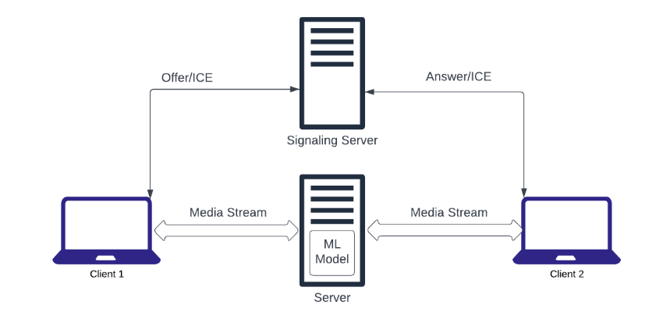
Architecture

Slide 8
Requirements
Hardware Requirements
CPU: Multi Core
GPU(optional)
RAM: 8 GB
Software Requirements
Operating System: Windows 10
Python 3.10

Slide 9
Libraries required to run the project:
ffmpeg-python
opencv-python
face_alignment
scikit-learn
pydub
pynormalize
soundfile
librosa
pysptk
pyworld
resemblyzer
streamlit
streamlit-webrtc
streamlit-server-state
streamlit-image-select

Slide 10
Challenges
We were facing difficulty with video call transmission on both the clients during second iteration, later we resolved this by trying out all the possible options with webrtc streamers,stun servers and ICE candidates.Finally Streamlit-server-state is used to create a separate session and this is used to establish connection between the clients.(Resolved)
Integration of model with video call application brought us many challenges right from input reception to the module dependencies.This library dependency was addressed by trying in multiple windows versions along with other operating systems and we were finally able to locate the file dependency and continued the development.(Resolved)

Slide 11
Contd..
We encountered another challenge as the model is developed to run on GPU using CUDA, which uses the GPUs for general-purpose processing. However,we encountered issues with the CUDA configuration, which prevented the model from running on the GPU.To address this issue, we decided to switch to running the model on a CPU instead of a GPU.(Resolved)
The other challenge is combining the stream of audio frames to the model as our model is only accepting a complete audio file in .wav format.The catch is here to modify the ML model so that it accepts the continuous frames of audio in accordance to the input stream.Tried multiple ways: Queues, DeepFake, Faceswap.

Slide 12
Real Time Face Swap
A video call application with minimum functionalities such as turning off the webcam or muting the audio has been created with the help of streamlit and streamlit-webrtc that allows two clients to communicate and swap faces using a selected image via media pipe.The call user interface consists of two webrtc streamers, one for sending and the other for receiving. The WebRTC protocol, streamlit_server_state, Stun server, and Ice candidates are used to establish a connection between the two clients. A streamlit session is created, and when the users click the start button, the video and audio are transmitted between the two clients. Users on the call can select an image and swap their face with the selected image in real-time. Once the user stops the webrtc streamer, the transmission ends and the call terminates.

Slide 13
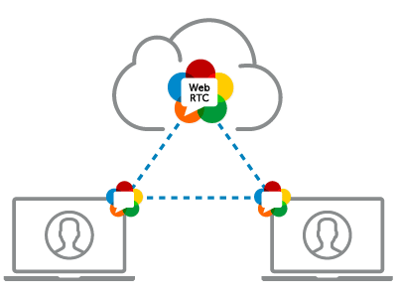
Project Demo

Slide 14
Demos involved
Talking Head Generation using MakeItTalk
Real Time FaceSwap using Mediapipe

Slide 15

Video Outputs(Audio Driven Talking head):

Slide 16
Real Time Face Swap

Slide 17
Conclusion A two-client video call application is built using Streamlit-WebRTC then the ML model is executed and thereby real time transmission is achieved. We have gained knowledge on WebRTC,Streamlit and also deployment of ML model in real-time environment.

Slide 18
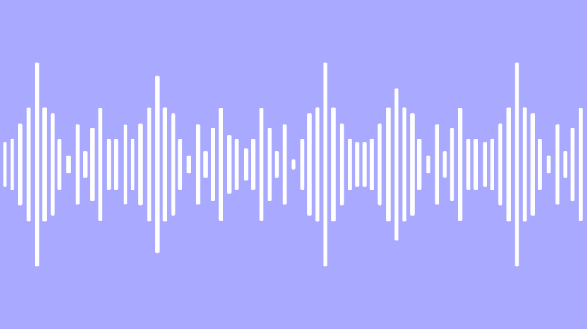
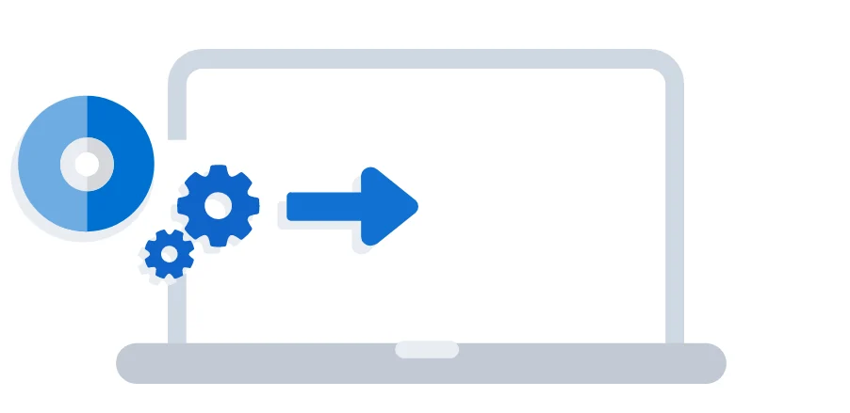
Thank You!

